Slide 1
Atomic Structure

Slide 2
The Structure of the Atom

Slide 3
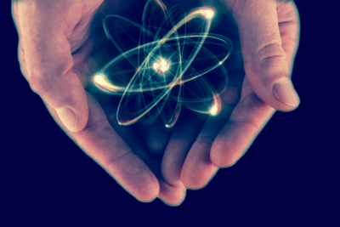
After you have completed this lesson, you should be able to:
Describe the structure of an atom in terms of the subatomic particles: protons, neutrons and electrons.
Identify and draw the location of these subatomic particles within a model of an atom.
State the charges on each subatomic particle, and explain how these contribute to the overall charge on an atom.

Slide 4
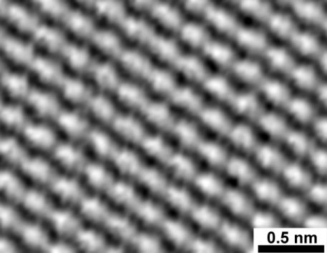
Atoms are the smallest particles of a substance that can exist while still possessing all the unique chemical properties of that substance.
Atoms can only be seen with an incredibly powerful microscope, and they look like tiny spheres, as you can see in the image below.
Atoms are so tiny that they cannot be seen except with a powerful microscope called a scanning tunnelling microscope (STM). They can be thought of as tiny spheres.

Slide 5
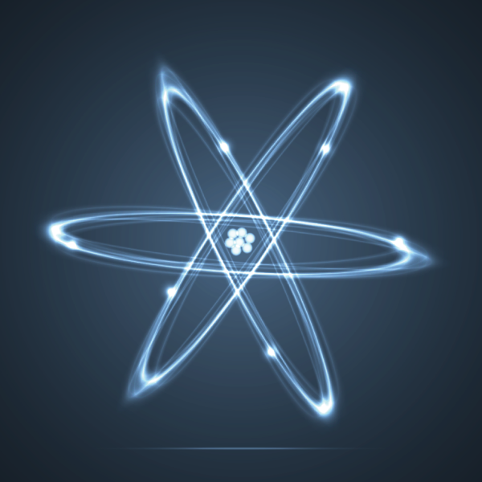
An atom is the smallest part of a substance that can exist and still possess all the unique chemical properties of that substance.
This is why they're called the building blocks of matter.
You might already know that atoms are actually made up of even smaller particles called protons, neutrons and electrons. Different types of atoms have different numbers of protons, neutrons and electrons.
However, protons, neutrons and electrons on their own do not possess the chemical properties of elements. It is only when they are in combination that substances with different properties are formed.

Slide 6
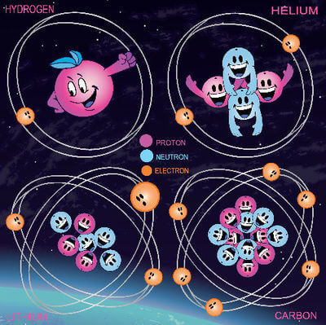
Different types of atoms have different numbers of protons, neutrons and electrons.
These different types of atoms are called elements. The term element also describes a substance made up of just one type of atom.
There are currently 118 known elements. They can be organised based on their properties into a chart called the periodic table. The periodic table gives you information about each element and the atoms that make it up.

Slide 7
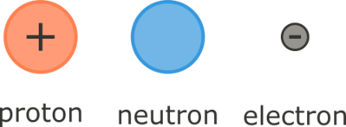
Atoms are so small that they cannot be seen without an extremely powerful microscope.
But atoms are actually made up of even smaller particles called subatomic particles ("smaller than an atom" particles). These are the protons, neutrons, and electrons.

Slide 8
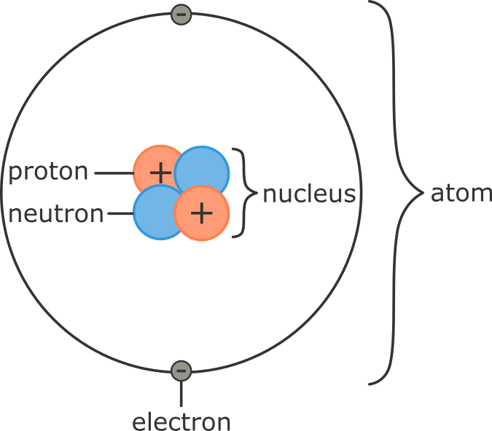
Protons and neutrons make up the nucleus, which is at the centre of the atom (nucleus means centre or core).
Electrons are found in orbitals (or shells) around the outside of the nucleus.

Slide 9
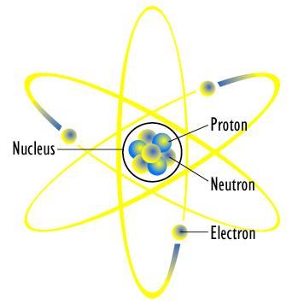
Protons are positively charged (+1); electrons are negatively charged (-1); and neutrons are neutral (have no charge; 0).
Protons and electrons have opposite charges to each other. Electrons are constantly moving in their shells outside the nucleus. The attraction between the electrons and protons holds the electrons in their shells.
Atoms have equal numbers of positively charged protons and negatively charged electrons, making them neutral (uncharged) overall.

Slide 10
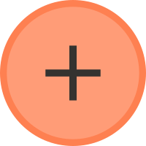

It is also important to look at the size of the subatomic particles.
Most of an atom's mass (about 99.9%) is made up of the protons and neutrons.
Protons and neutrons each have a mass of 1.67×10⁻²⁴ g. This is such a tiny number that a new unit of mass is used: the atomic mass unit amu).
Using these units, protons and neutrons both have a mass of 1 amu.

Slide 11
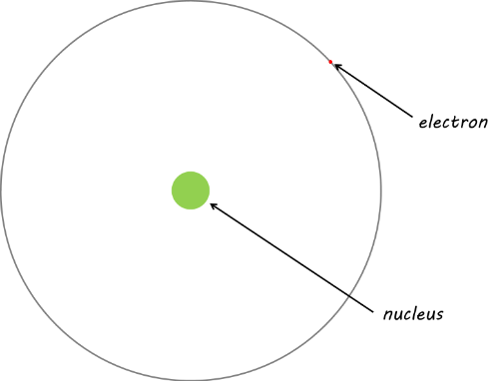
Electrons are 1840 times smaller than protons and neutrons, with a mass of 0.00549 amu.

Slide 12
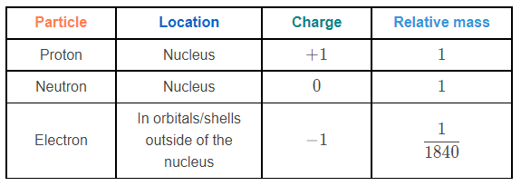
This table summarises the information you need to know about the subatomic particles:

Slide 13
Atomic Number

Slide 14
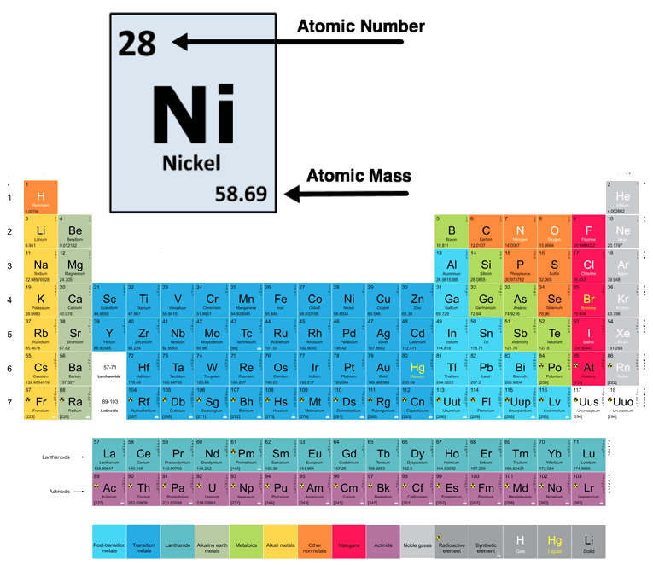
In this Smart Lesson you will learn to:
Recall that elements are represented by symbols.
Explain that the atomic number is based on the number of protons in an atom.
Describe how the periodic table is based on the atomic number and the properties of the elements.

Slide 15
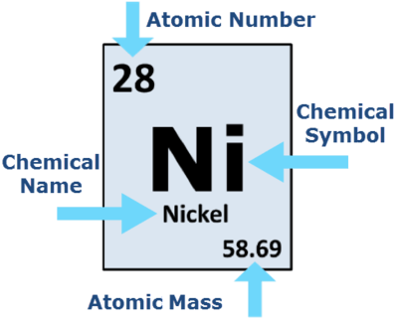
The symbol representing the element can be chosen in several ways:
Many elements uses the first letter of their names. For example, oxygen is O, phosphorus is P and nitrogen is N.
When a letter is already taken (chlorine can't be C because that's carbon) most elements will use two reasonable letters. For example, chlorine is Cl, calcium is Ca and zinc is Zn. The first letter is a capital letter, but any other letters are lower case.

Slide 16
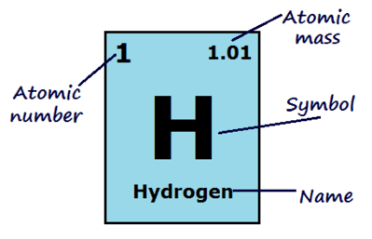
The atomic number of an atom is how many protons the nucleus has.
This is what defines an element! If an atom has 1 proton it is hydrogen, if it has 8 protons it is oxygen and if it has 94 protons it is plutonium.

Slide 17
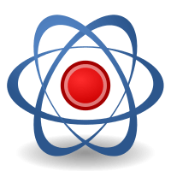
Atoms are neutral.
They have the same amount of electrons as protons, so the atomic number of an atom is also how many electrons it has.

Slide 18
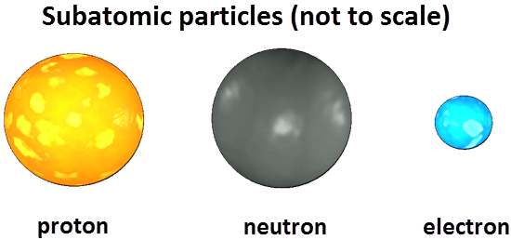
The mass number is the mass of one atom of an element.
It is the number of protons plus the number of neutrons in the nucleus of the atom.
Electrons are not considered when calculating the mass number because their mass is so small compared to protons and neutrons.

Slide 19
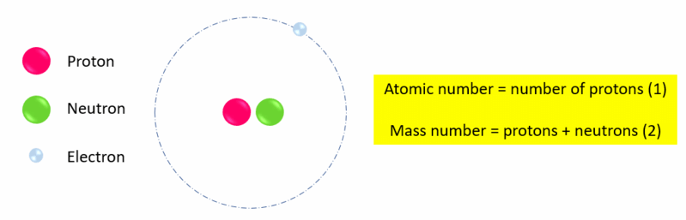
To find the number of neutrons in an atom, subtract the atomic number from the mass number:
mass number - atomic number = number of neutrons
For example, the mass number (number of protons + neutrons) of one form of hydrogen could be 2, and the atomic number (number of protons) is 1. Therefore the number of neutrons in this hydrogen atom is 2−1=1.
The number of neutrons must always be a whole number (should not include any decimal places).

Slide 20
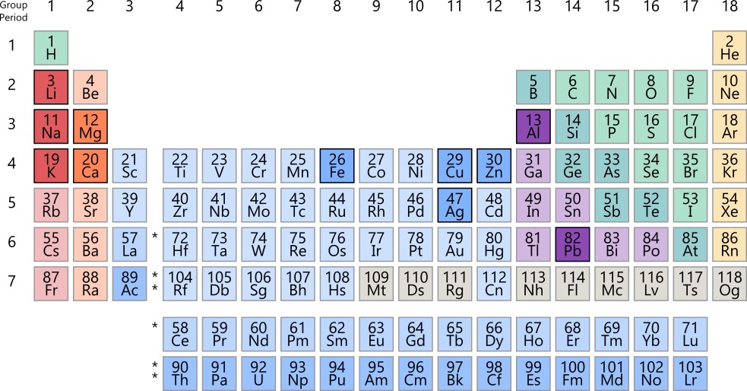
Because elements are only defined by the number of protons they have, they can have different numbers of neutrons.
Both neutrons and protons contribute to the mass of an atom, so different atoms of the same element can have different mass numbers.
Atomic mass is the average mass number of an element. Being a calculated average, the atomic mass is usually not a whole number. This is the value displayed on the periodic table alongside the atomic number.

Slide 21
What are Isotopes?

Slide 22
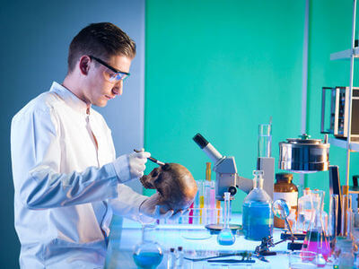
In this Smart Lesson you will learn all about isotopes.
Isotopes are very important because they are responsible for radioactivity. This is also what makes them useful for scientists trying to find out how old things like dinosaur bones are, or where they are from.

Slide 23
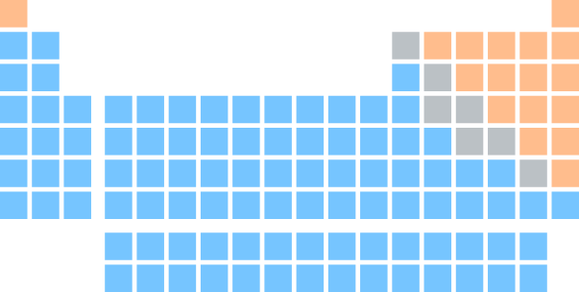
Isotopes are atoms of the same element that have different numbers of neutrons, but the same number of protons and electrons.
This means that the mass number changes while the atomic number remains the same.

Slide 24
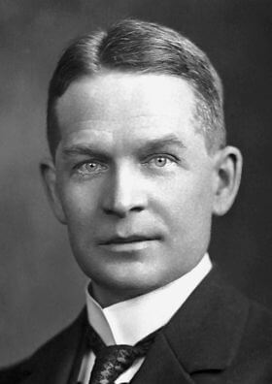
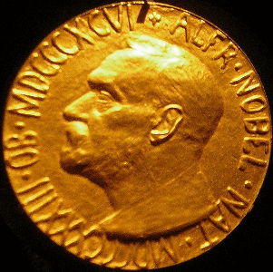
The existence of isotopes was first proposed by Frederick Soddy in {1913}1913. Soddy was a British chemist who worked with Ernest Rutherford to study radioactive elements. He received a Nobel Prize in {1921}1921 for his theory of isotopes.

Slide 25
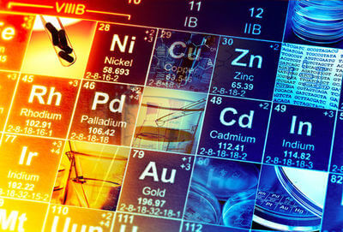
Soddy's experiments showed that atoms of the same element could have different atomic masses but identical chemical properties.
He named this concept isotope, which means same place, because these atoms were found in the same place on the periodic table.
At the time, scientists could not come up with a good explanation for how this occurred.

Slide 26
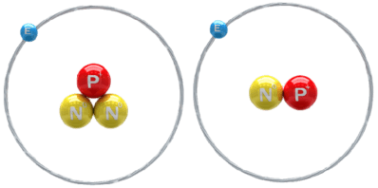
When neutrons were discovered in 1932, the problem was solved!
Atoms with the same number of protons had different masses because they had different numbers of neutrons. These atoms have the same properties because neutrons do not affect the chemical properties of elements.

Slide 27
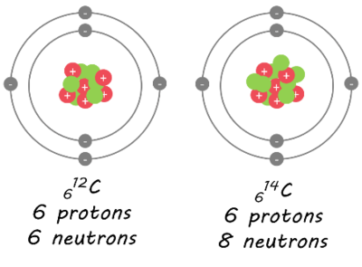
Isotopes are named based on their mass number. The element's name is written first, followed by the mass number.
For example, these are two carbon isotopes. The first one has a mass number of 12, so is called carbon-12. The second one has a mass number of 14, so is called carbon-14.

Slide 28
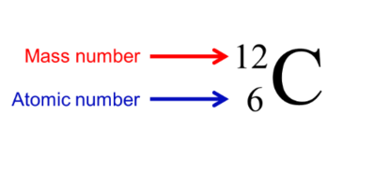
Isotopes are often represented using atomic symbols. The atomic symbol shows the chemical symbol of the element, with the mass number and atomic number written to the left. For example, carbon-12 is written like this:
The mass number is the larger number (number of protons plus neutrons) and this is written at the top. The atomic number is the smaller number (number of protons) and this is written at the bottom.

Slide 29
Note: on the periodic table, the box that contains the chemical symbol of the element will usually have the atomic number at the top, because that is the number that determines the identity of the element and its place in the periodic table.
However, the convention for writing out atomic symbols is to write the mass number at the top, because the mass number determines the identity of the isotope.

Slide 30
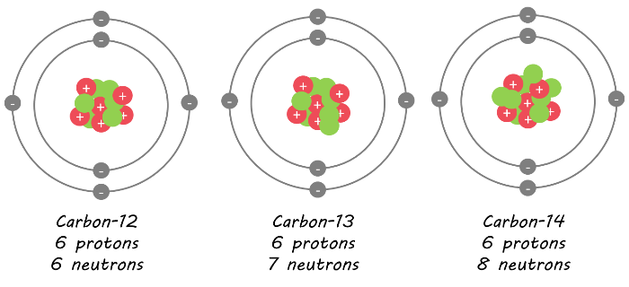
Different isotopes of elements are found in different amounts in nature. This often depends on how stable the isotope is. You will learn more about the stability of different isotopes in the lessons on radioactivity.
For example, carbon-12 is the most stable isotope of carbon, while carbon-14 is unstable. This means that in nature, there is much more carbon-12 than carbon-14.

Slide 31
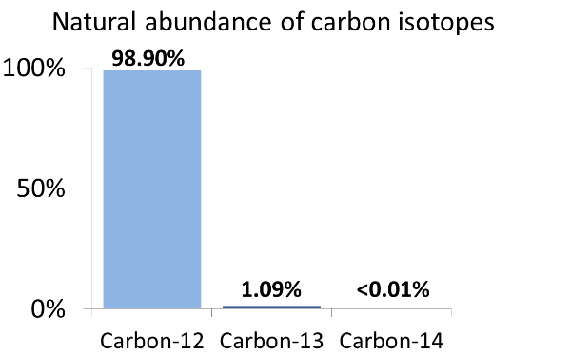
Carbon is the sixth most abundant element in the universe. This graph shows approximately how much of each isotope of carbon makes up all the carbon found in nature. About 98.9% of all carbon is the carbon-12 isotope.

Slide 32
You may have noticed that on the periodic table the mass number of carbon is shown as 12.011. The mass number is the number of protons plus neutrons in the nucleus, but we cannot have 0.011 of a proton or neutron!
The number shown on the periodic table is known as the relative atomic mass and is an average mass of all isotopes of carbon based on how abundant they are in nature. Since carbon-12 makes up 98.9% of all carbon found in nature, the relative atomic mass of carbon is very close to 12.

Slide 33

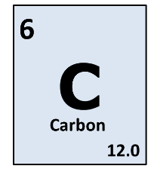
Carbon-12 is used as a standard for calculating the relative atomic mass of other elements.

